Slide 1
BUSA3015 – Regression Analysis of Online Retail Sales Data
Jett Munnings (47789115)

Slide 2
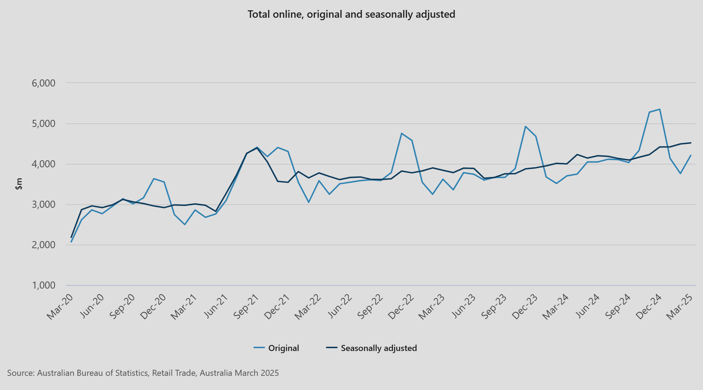

Attribution
Sourced from Australian Bureau of Statistics: Catalogue number 8501.0
Original and Seasonally Adjusted total sales volume for online retailers $millions.
Using values of original time series from the Feb-2022 – Jan-2025

Slide 3
Analysis
Seasonal data and upward trend present. Series has consistent peaks within November of each year in exception to a peak in December 2024, with troughs in February
Within sample forecast shows poor generalization due to limited training data, only being trained on two seasonal cycles
Overall model captures seasonal relationship between variables and general trend well, however, is not attuned to the external economic environment leading to inaccuracies on a month-by-month basis

Slide 4
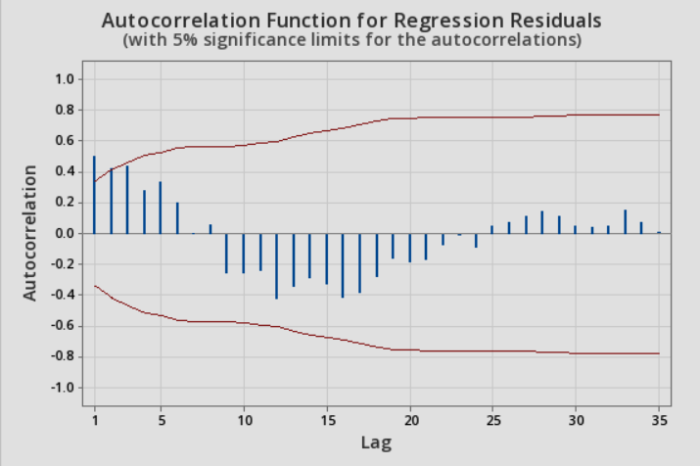
Articulation Of Issues
Regression model exhibits critical issues: this including autocorrelation in residuals as well as most explanatory variables within the model being statistically insignificant in relation to the baseline month (January). Predicted Y vs Residuals also indicate slight heteroskedasticity, however its impact is highly limited given the low frequency of observations for higher predicted values.
Significance F
1.27444E-14
 | Coefficients | Standard Error | t Stat | P-value
Intercept | 3279.90 | 82.42144086 | 39.79426 | 1.03E-22
Time | 20.97 | 1.982751711 | 10.58 | 2.63E-10
Feb | -282.50 | 97.63919829 | -2.89333 | 0.008198
Mar | 60.43 | 97.21551138 | 0.621586 | 0.540327
Apr | -144.44 | 96.83057817 | -1.49169 | 0.149369
May | 161.86 | 96.48486252 | 1.677523 | 0.10698
Jun | 141.32 | 96.17878732 | 1.469341 | 0.155287
Jul | 107.45 | 95.91273207 | 1.120289 | 0.274153
Aug | 112.65 | 95.68703061 | 1.177247 | 0.251136
Sep | 62.21 | 95.50196902 | 0.651412 | 0.521237
Oct | 279.61 | 95.35778393 | 2.932203 | 0.007489
Nov | 1243.87 | 95.25466096 | 13.05839 | 4.02E-12
Dec | 1106.30 | 95.19273356 | 11.62171 | 4.18E-11
Notes:
While the trendline for our residuals is consistently across 0, there is a clear cyclic pattern of residuals. This indicating potential autocorrelation
This finding is confirmed through our autocorrelation plot, where lags 1-3 are exceeding the 95% significance boundaries. This meaning residuals are not independent thus violating a key assumption of the regression model.
Looking into the regression output itself, we can deduce through the regressions F significance that the overall model is highly significant, with an F statistic of 1.27e-14.
however, only 5 out of 12 dummy variables are found to be statistically significant, this including time, February, October, November and December. This meaning we cannot make predictions within the months March through to September with 95% confidence.
Overall, our regression model exhibits critical issues: this including autocorrelation in residuals as well as most explanatory variables within the model being statistically insignificant. This compromising the model's ability to make reliable forecasts

Slide 5
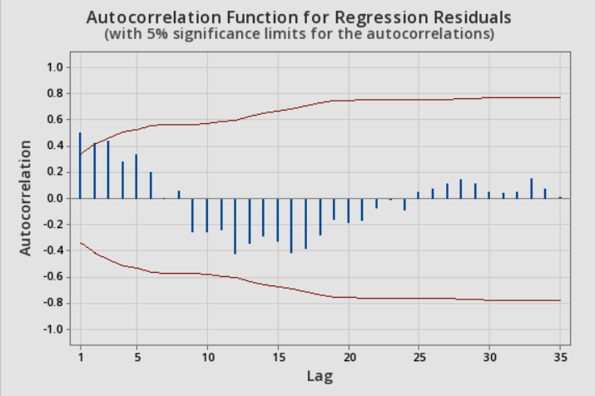
Critique and Position
Model Evaluation:
Model is significant as indicated by our F significance statistic.
Dummy variables (March – September) with p-values > 0.05 indicate we cannot make predictions within these months with 95% confidence.
Key assumption of the regression model has also been violated. With evident autocorrelation of errors/residuals being present within lags 1-3.
We can conclude that it is not appropriate to utilize this model for forecasting purposes extending from Feb-25 – Jan-26.
Notes:
Model Evaluation:
Model is significant as indicated by our F significance statistic, confirming the model is able to explain a large proportion of how the sales volume fluctuates across previous years.
However statistical insignificance of dummy variables (March – September) with p-values > 0.05 indicate we cannot make predictions within these months with 95% confidence. This meaning only months February, October, November and December are significant within this specific model.
As previously mentioned, a key assumption of the regression model has also been violated. With evident autocorrelation of errors/residuals being present within lags 1-3. Showing that the model does not capture the complete relationships between the dependent and independent variables within the regression.
Without several months being statistically significant, as well as evident autocorrelation within residuals. We can conclude that it is not appropriate to utilize this model for forecasting purposes extending from Feb-25 – Jan-26. This as its predictive power is severely limited by these violations and components of statistical insignificance.

Slide 6
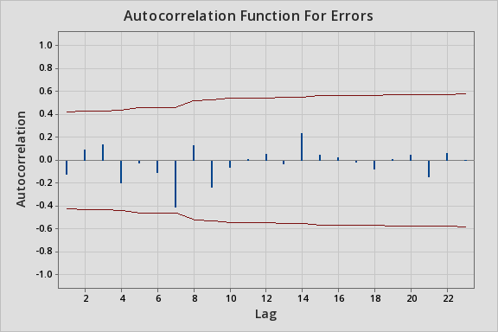
Critique and Position
An optimized Winters Exponential Smoothing model is a much more appropriate model to adopt for forecasting sales volume of online retailers. This as the model effectively captures the relationship between each month and sales volume as evident through no autocorrelation of errors.
However, MSE of Winters Exponential Smoothing model is higher (16706.77) than our regression (8690.32) in our within sample forecasts. Despite this, WES is still more appropriate due to its ability to meet model assumptions and capture seasonal patterns.
Optimally, combining this model with leading indicators such as the consumer confidence index or google trend data for online retailers would alleviate some of the generalization present within the within sample and out of sample forecasts, and mitigate this higher error rate.

